Slide 1
Breast reduction
Sisimit Iris

Slide 2
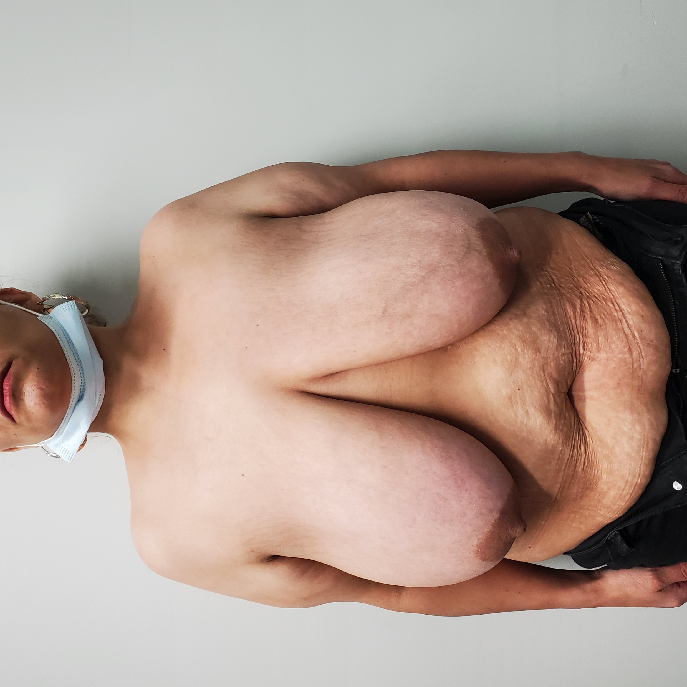
12.15.2023

Slide 3
Plan
Mark 7-9 cm limbs
Ancef 2 gm
Instruments
  Breast reduction
  Liposuction cannulas
Foley
Scratch marks – 18Ga
Drapes – 3 x ¾ sheets, 1 split, 1 full drape
Tumescent
  1 L LR+
  40 ml Lido 1% +
  1 amp Epi 1:1,000
42 mm cookie cutter
Strangulate, de-epithelialize
Superior flap dissection – Adair clamps
Excise, weigh specimen – scale
Pec 1 block: Exparel 20 ml+ 0.5% Marcaine 20 ml + NS 20 ml
#1PDS –SH – secure pedicle
JP x2
Drape skin over the pedicle - staple
Repeat on the Left side
Sit up
Measure nipple position – 2-0 silk tie
Closure – #1 PDS – SH, 2-0 Monoderm barbed bidirectional 30/30 cm, 3-0 Monocryl PS2, 5-0 chromic, 3-0 Nylon for drains.
Dressing 4 x 8, long tegaderms, Bra

Slide 4
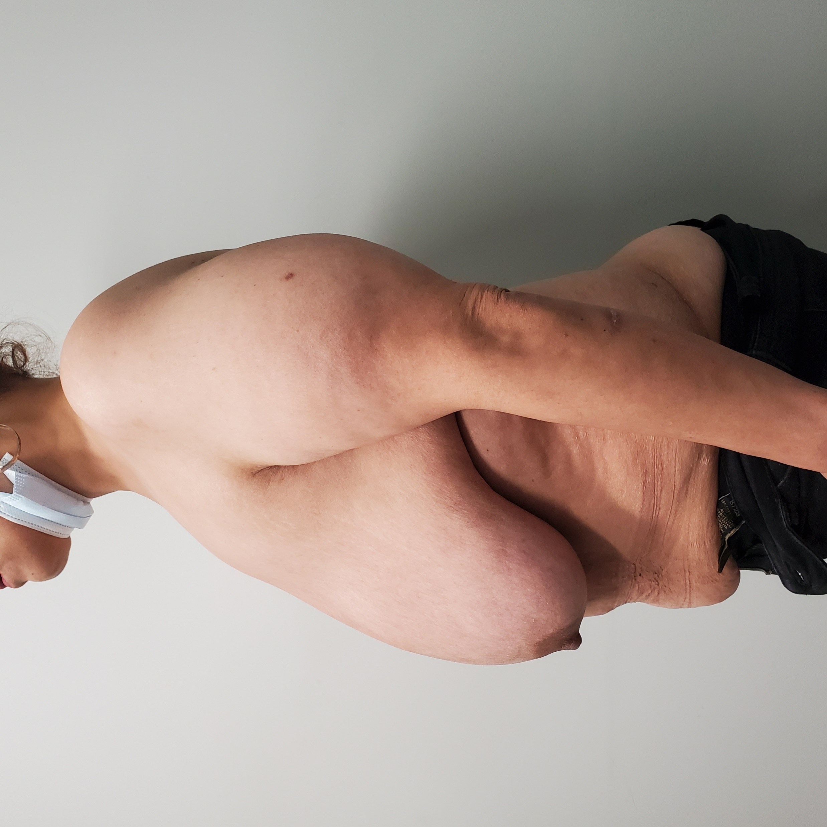
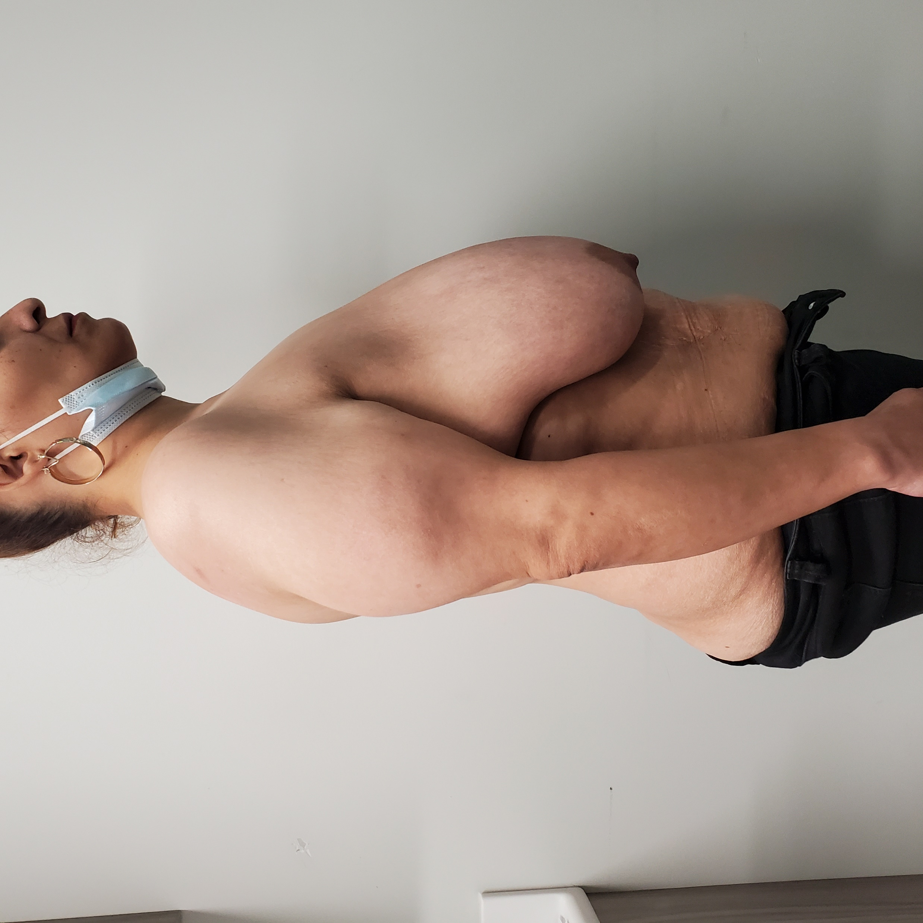

Slide 5
